Slide 1
Translation of Research into Practice: Removing Barriers and Preventing Hospital-acquired Infections
Indiana Organization of Nurse Executives
Fall Conference 2019

Slide 2
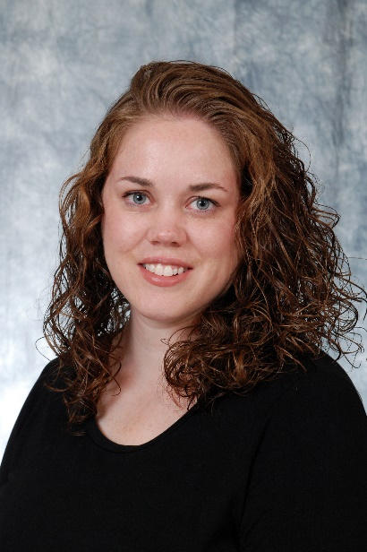
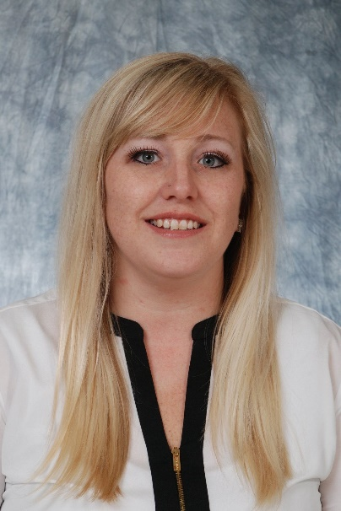
Heather Demaree BSN, RN, CMSRN Clinical Operations Manager Medical Stroke Unit Kristin Kaboski BSN, RN Clinical Operations Manager Medical Telemetry Unit

Slide 3
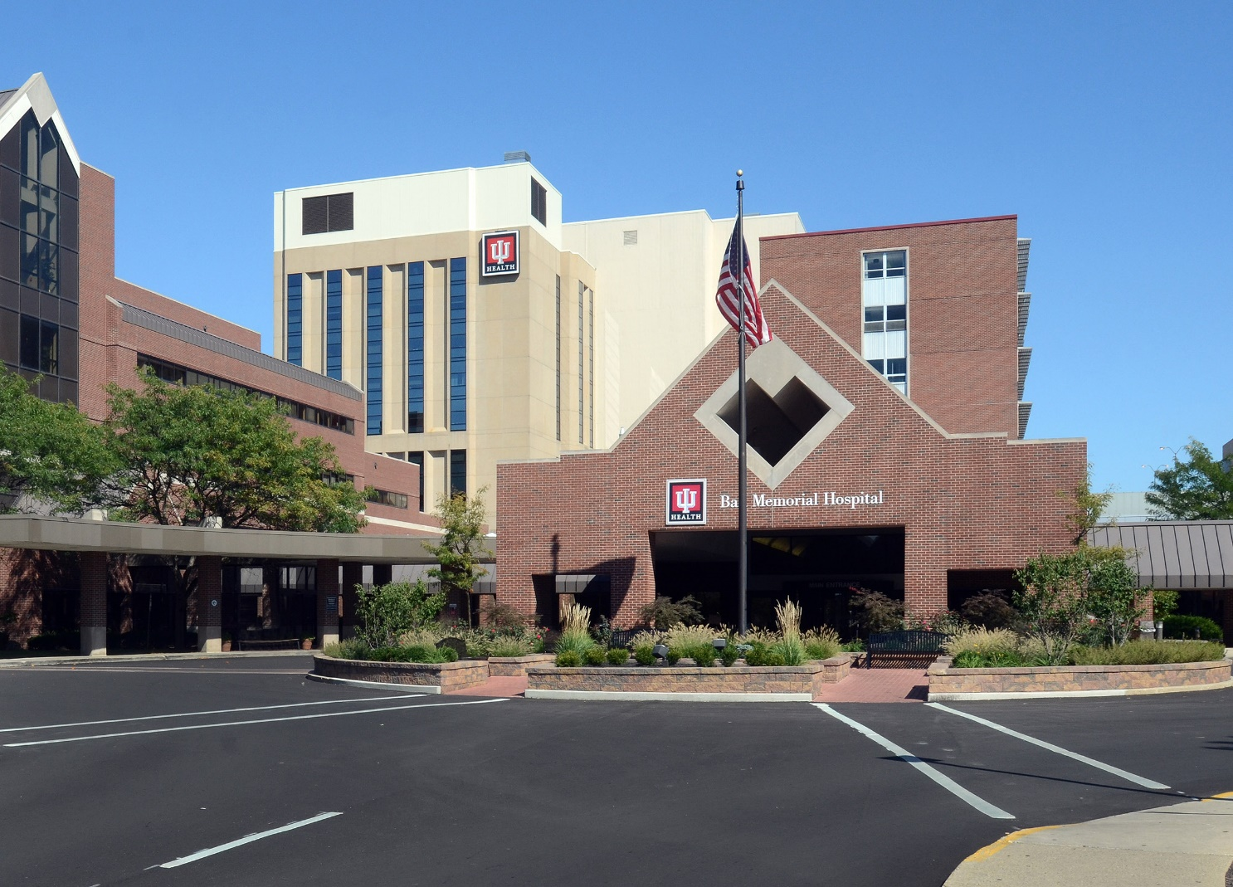
Indiana University Health Ball Memorial Hospital Muncie, Indiana

Slide 4
Overview of the Session
Background: where we came from
Note resources that were helpful
Describe the process of developing a plan for translating evidence into practice
Overview the plan
Outcomes, both process outcomes and patient safety outcomes
Notes:
We will provide some background and context for this session – where we were “back then” when our story began.
Note resources that were helpful
Describe the process of developing a plan for translating evidence into practice
Overview the plan - how did we promote nurse uptake of evidence-based practices.
Outcomes, both process outcomes (what worked and what didn’t in getting nurses to do the new activities) and patient safety outcomes

Slide 5
Background
We have many evidence-based practices that are not being implemented.
Notes:
We have many evidence-based practices that are not being implemented.
Most patients in the health care system only receive 50% of the evidence-based care that is available to them.
While it is true that some health care circumstances still lack adequate research-based strategies to manage, the health care system is failing at implementing many practices that we know are based on evidence.
While the unit was aware that there were evidenced based guidelines for preventing hospital-acquired infections, they were not being enacted on our unit.

Slide 6
Background
The Medical Stroke Unit is a 25 bed unit that cares for medical level patients.
Average daily census of 23 patients.
Budgeted for 40 FTE’s
Notes:
The Medical Stroke Unit is a 25 bed unit that cares for medical level patients.
Stroke specialty: all nurses are NIH stroke scale certified
Many other medical diagnosis such as altered mental status, COPD exacerbation, UTIs, sepsis, cellulitis, renal failure, falls, dehydration, pneumonia, alcohol and opiate withdrawal, etc.
Average daily census of 23 patients.
Budgeted for 40 FTE’s of direct patient care providers (Registered nurses and patient care technicians)
Average workload is 6 patients per one nurse and 8 patients per patient care technician.
Hard to recruit and retain on the unit. Very busy unit and hard work
Many team members resistant to change as they saw it as adding more work.

Slide 7
Background
In 2017, our safety indicators for infection were the lowest in the hospital.
Other units were having success at implementing the system-wide initiative for harm prevention, but our unit lagged behind.
We had committed, smart nurses who cared deeply for their patients, but harm continued to happen.
We had so many reasons as to why we couldn’t do it
Something had to change.
Notes:
In 2017, our safety indicators for infection were the lowest in the hospital.
Other units were having success at implementing the system-wide initiative for harm prevention, but our unit lagged behind.
We had committed, smart nurses who cared deeply for their patients, but harm continued to happen.
We had so many reasons as to why we couldn’t do it
Something had to change.

Slide 8
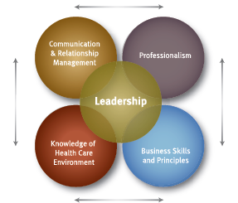
AONE Competencies
AONE, 2011

Slide 9
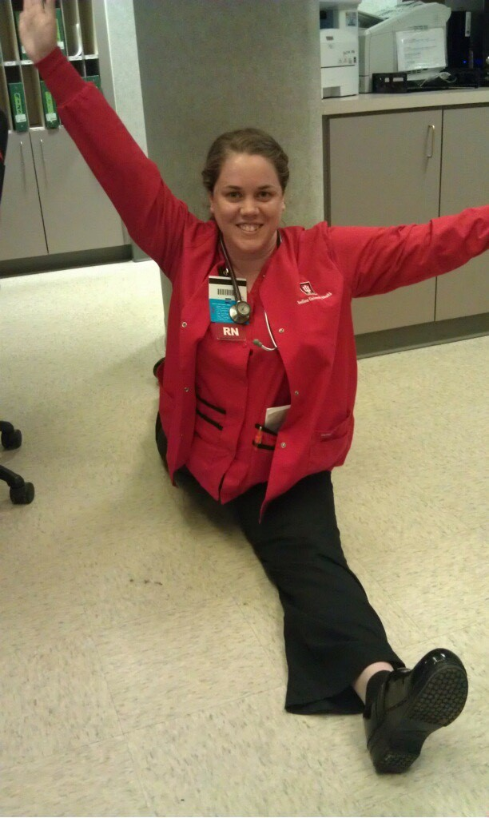
Development of a Leader
Little manager training or preparation
Received my training from fellow managers, my director, attending leadership meetings and accumulating my own experiences
My director helped me formulate a professional development plan
Notes:
Little manager training or preparation
Served as the units charge nurse for two years
Never been in a management position
Peer-to-leader transition difficulties
Received my training from fellow managers, my director, attending leadership meetings and accumulating my own experiences
My director helped me formulate a professional development plan that moved me directly or indirectly forward in addressing these competencies, all within the immediate context of stopping harm events

Slide 10
Development of the Informal Leader
Served as charge nurse on unit for 5 years
Served the unit at the Unit Based Council chairperson
Has worked on the unit for 11 years
Had a good rapport with all team members
Has been on many different leadership councils and educational activities
Helped to onboard/train new team members

Slide 11
Collaboration
Getting buy in from an informal unit leader
ANA/ANOE Principles for Collaborative Relationships between Clinical Nurses and Nurse Managers
Here are the principles we followed
Effective communication
Active listening
Creating safe environment without shame or blame
Speaking directly to the person who needs new information

Slide 12
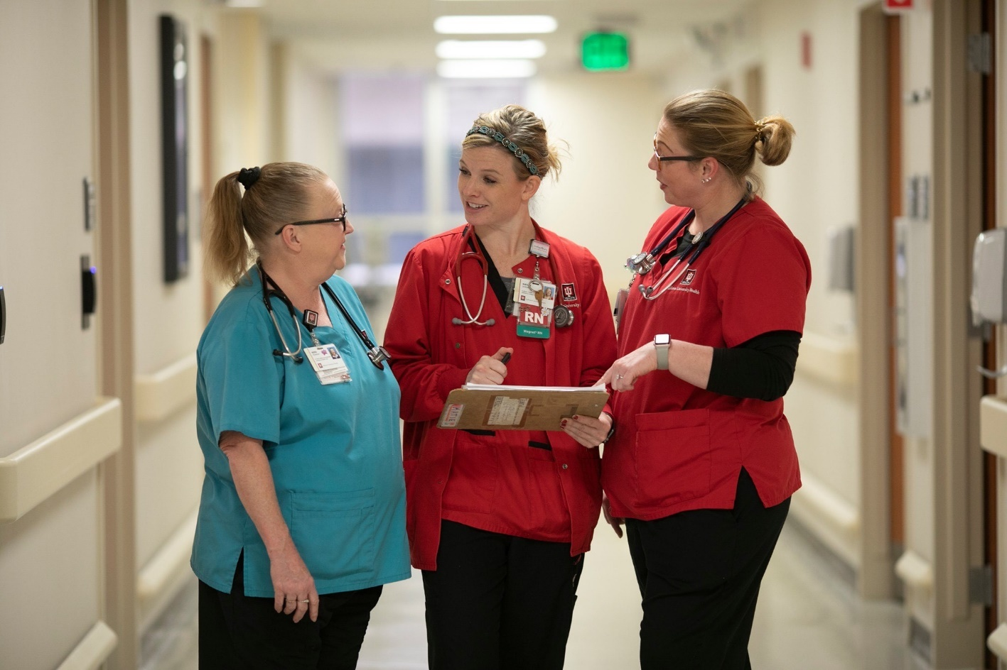
The Principles of Collaboration
Effective communication

Slide 13
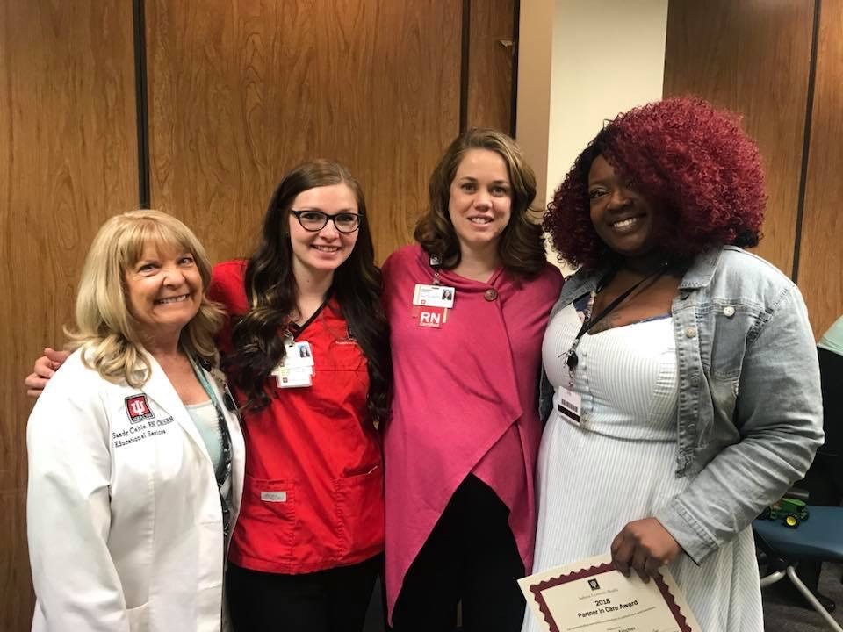
The Principles of Collaboration
Authentic Relationships

Slide 14
The Principles of Collaboration
Learning Environment and Culture

Slide 15
The Initiative: First Efforts
Our system rolled out an aggressive harm reduction program
The program offered evidence-based strategies,
Spread the word to the unit.
Other units were able to demonstrate success, while ours was failing to do so.
Notes:
Our system rolled out an aggressive harm reduction program targeting CLASBI, CAUTI and Cdiff.
The program offered evidence-based strategies, such as….(dressing changes on central lines, scrub the hub, protocol for removing catheters, cath care and peri care, daily bath and linen changes, Etc….
So, we announced the program in unit meetings, had assigned electronic learning modules for RNs and PCAs, and posted a copy of the new procedures in the staff bathroom and thought that would surely do it.
Our outcomes remained dismal, still the lowest of all inpatient units in the hospital.
Other units were able to demonstrate success, while ours was failing to do so.

Slide 16
The Initiative: Starting Again
Gathered a team
Kristin was a key leader along with other well-intentioned nurses who were motivated to achieve zero harm
Took the procedures from the system for prevention of HAI and checked the evidence.
Identify what aspects of the procedures were non-negotiable.
Created a tool to utilize
Created standard work for using the tool
Notes:
Gathered a team consisting of clinical nurses, unit educator, medical-surgical clinical nurse specialist, the associate chief nurse of practice and a member from the office of transformation and empowered them to own the implementation
Kristin was a key leader along with other well-intentioned nurses who were motivated to achieve zero harm
Took the procedures from the system for prevention of HAI and checked the evidence.
Identify what aspects of the procedures were non-negotiable. These aspects had to happen every time. There were other aspects that could be tailored or prioritized differently.
Created a tool to utilize
Created standard work for using the tool

Slide 17
Barriers
Too much work
Not enough time
Not enough Staff
Change resistant (too much change)
Compassion fatigue
Accountability
Lack of understanding
Notes:
Once we knew the must-haves, we focused on barriers to rolling out the HAI prevention plan. What obstacles were we facing and how could we form a plan to minimize the barriers
Too much work
Not enough time
Not enough Staff
Change resistant (too much change)
Compassion fatigue
Accountability
Lack of understanding

Slide 18
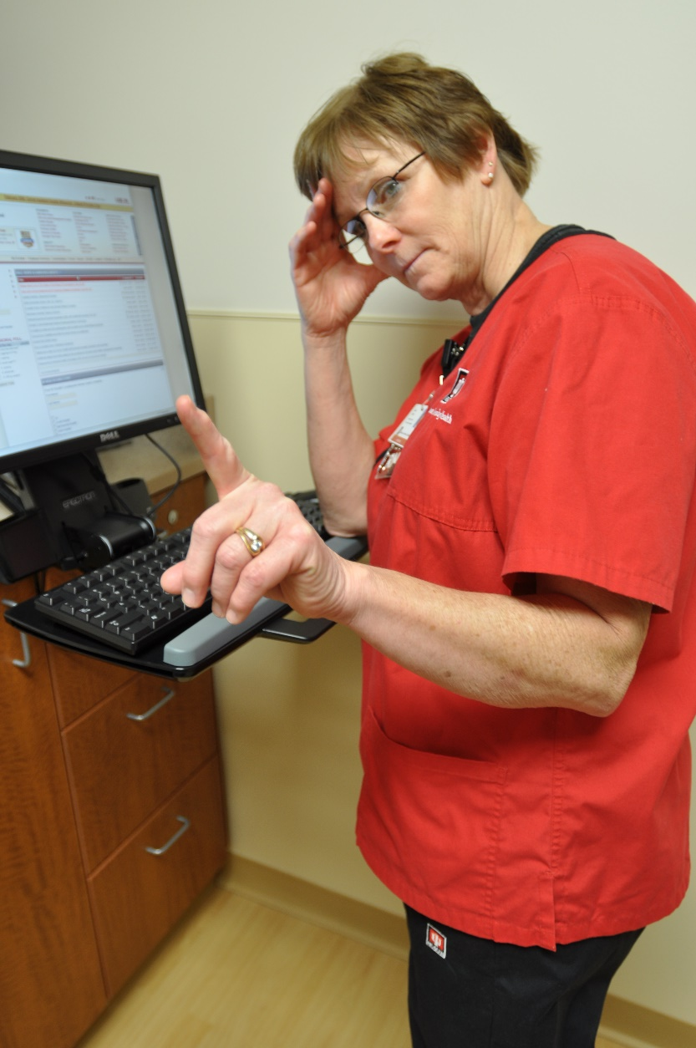
Barriers Continued
The work seemed invisible
No recognition of completion of task
The work, whether completed or incomplete was invisible
No one knew the work was complete
Team did not feel comfortable holding each other accountable
Leader did not hold team members accountable

Slide 19
Putting It All Together
Made a proposed plan from the managers perspective
Encouraged the team to modify and expand from their perspective
They had great suggestions.
Worked with the whole team to finalize the plan
Finalized the tool to be used.
Rolled out implementation to the unit in October of 2018
Notes:
Made a proposed plan from the managers perspective and shared it with the team.
Encouraged the team to modify and expand from their perspective
They had great suggestions.
Worked with the whole team to finalize the plan, utilizing evidenced based research and the AONL guiding principles
Finalized the tool to be used. *Shown on the next slide
Rolled out implementation to the unit in October of 2018

Slide 20
Notes:
Note: This ‘Body Slide: Image (More Space)’ template should be used sparingly.
Only use this slide template with:
A large visual or infographic
Images with white backgrounds that cross over the curved line (in main body slides) and cannot be made transparent.
Large, complex graphs where the curved line interferes with the data
Any content that gets too close to the IU Health Icon in the bottom-right corner

Slide 21
Implementation
Started with a Safety Huddle every shift
Charge nurse lead
All team members from the shift attended
Huddle happens at 11am and 11pm
The tool was utilized and discussed.
Action items for incomplete “must haves” were identified and assigned
Visual tool of the MDI board was utilized for completion of tasks
Notes:
Started with a Safety Huddle every shift
Charge nurse lead
All team members from the shift attended to discuss the patients on the unit for the day.
Huddle happens at 11am and 11pm so that the team had time to know their patients before huddling
The tool was utilized and discussed. “Who had a urinary foley?, Who had a central IV line?, Who are we worried about for c-diff infection?”
Action items for incomplete “must haves” were identified and assigned
Visual tool of the MDI board was utilized for completion of tasks

Slide 22
Tracking
Utilization of the MDI (managing for daily improvement) board
Posted the tool once huddle was completed
Notes:
Utilization of the MDI (managing for daily improvement) board
Posted the tool once huddle was completed
Team members will fill in bubbles once their action item was complete.
In an area that was visible to all team members that served as a constant reminder
All team members owned the action items and ensured they were done
Any barriers to completion of items were identified and a collaborative approach was used to remove them

Slide 23
Safety Huddle Video

Slide 24
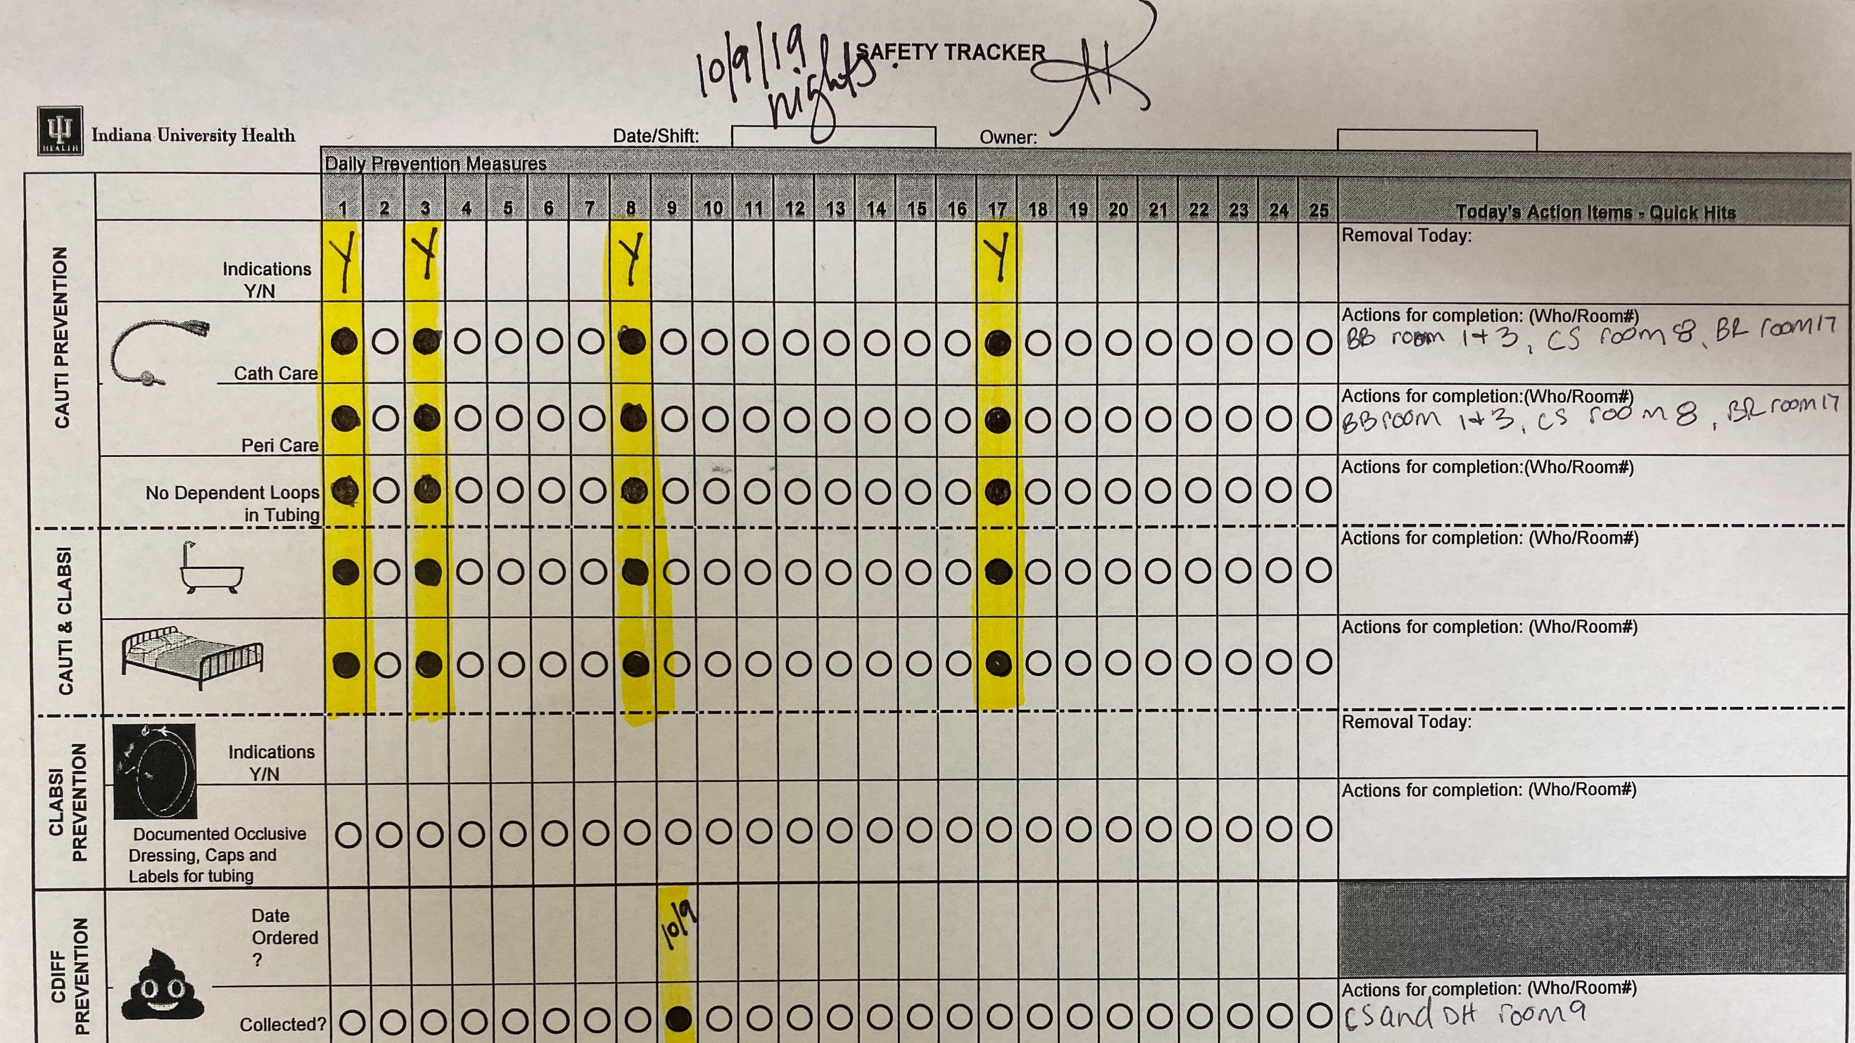

Slide 25
“Remember, you are consciously making a decision to potentially harm a patient if you do not follow standard work and that is not ok!”
Notes:
We’re selling t-shirts and cups with this logo after the session

Slide 26
Real Time Follow Up
Utilized the tool
Manager spent time on the floor to get to know the patients
Attended safety huddle
Manager strengthened skill set by embracing effective communication and building authentic relationships
Notes:
Utilized the tool for visual management of completion of tasks
Manager spent time on the floor to get to know the patients
Took part in interdisciplinary rounding
Chart audits for those with devices or concern for c-diff infection
Alerted team members of missed care
Attended safety huddle
Encouraged team members to look further into patient information if the reason was not clear for them to have the device or order for c-diff collection
Manager strengthened skill set by embracing effective communication and building authentic relationships

Slide 27
Process Results
In 2018, MSU had a total of 9 harm events
Process has been in place for one year now
MSU has had one c-diff event since implementation
Notes:
In 2018, MSU had a total of 9 harm events
Process has been in place for one year now
MSU has had one harm event since implementation
C-diff infection on a patient who contracted it on day 21 of their stay after being treat for osteomyelitis and having multiple co-morbidities
The Unit Based Council, consisting of the unit leaders, met quarterly to evaluate the tool and process
As a result, the tool has been modified
MSU will now add falls and hospital acquired pressure injuries to the tool to help prevent them.
Team really owns the process and are able to hold each other accountable
Spreading it to other units in the hospital

Slide 28
Outcome Results
 | 2017 | 2018 | 2019
CAUTI | 1 | 2 | 0
CLABSI | 1 | 1 | 0
C-DIFF | 9 | 6 | 1

Slide 29
Sustainment
Cycle of evaluating, improving, celebrating and valuing evidenced-based practices to prevent patient harm
Follow up with team regarding quality of huddle
Education given to newly hired team members
Hospital safety squad evaluating for best practice to make sure that we are doing what is best for patient
RCA for harm events if they occur
Notes:
Cycle of evaluating, improving, celebrating and valuing evidenced-based practices to prevent patient harm
Follow up with team regarding quality of huddle
Emails to those with missed action items
Education given to newly hired team members
Hospital safety squad evaluating for best practice to make sure that we are doing what is best for patient
Using IOWA model, reinforcing as needed and monitoring key indicators
RCA for harm events if they occur
Office of infection prevention, CNSs, unit representative, manager, quality director

Slide 30
Safety Squad
Hospital group
Addresses CAUTI, C-Diff, CLABSI and Falls
Multi disciplinary team members
Monthly meetings

Slide 31
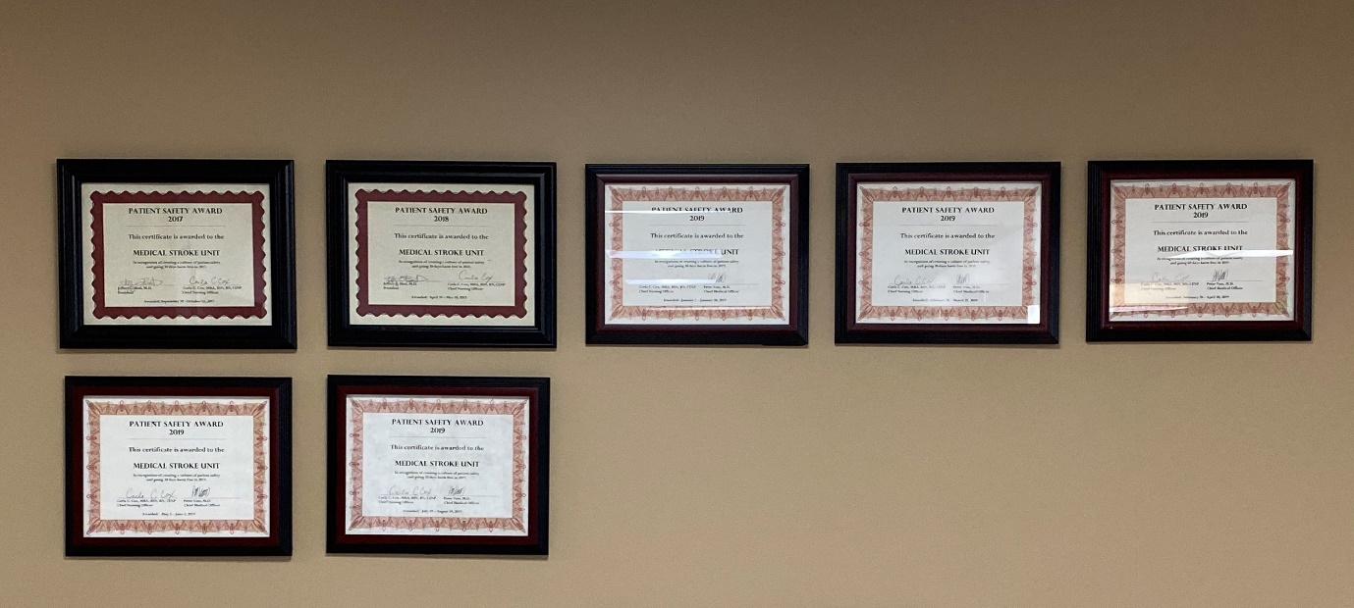
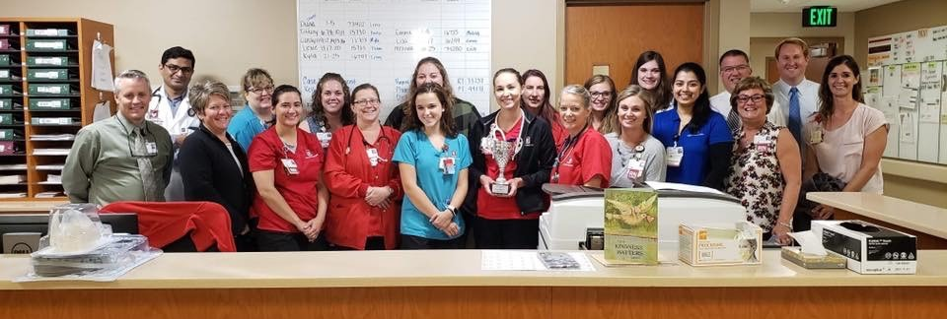
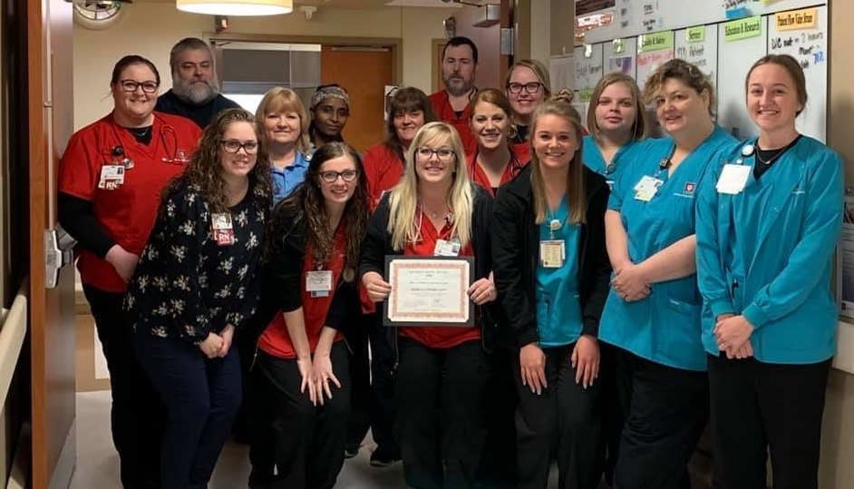
CELEBRATION!!!

Slide 32
Follow-Up with Team Members
Follow-up received well from team members
Not a blame game
Able to provide teaching moments
Most were not “repeat offenders”
Have not had to put anyone on a corrective action or warning
CNS and unit educators available to answer questions, be sounding boards, etc.
Notes:
Follow-up received well from team members
Not a blame game, more of identifying barriers as to why the task was not completed
Able to provide teaching moments, in real time, if needed to help team members what is expected of them and how to do it.
Most were not “repeat offenders”
Have not had to put anyone on a corrective action or warning
CNS and unit educators available to answer questions, be sounding boards, etc.

Slide 33
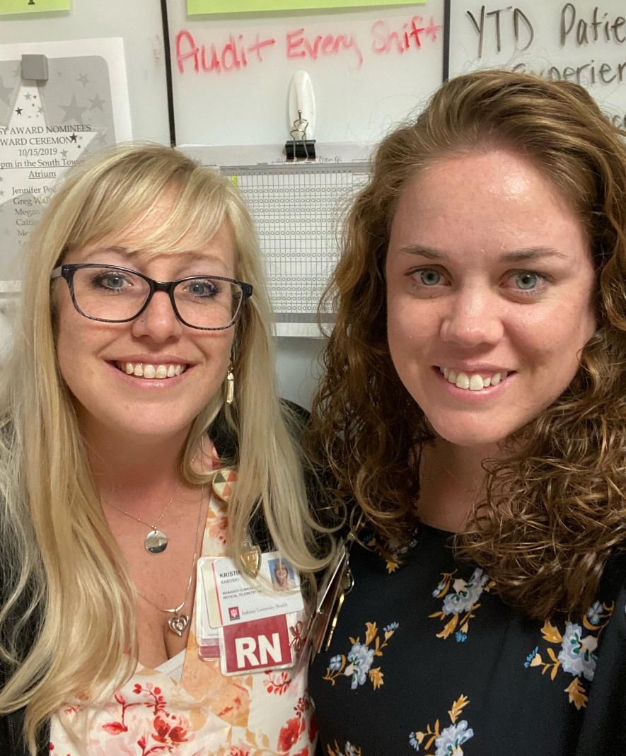
Outcome of Manager-Clinical Nurse Collaboration
Kristin was able to help coach and mentor fellow team members
Helped drive action plan and completion of key items
Kristin’s move to Clinical Operations Manager of the Medical Telemetry Unit
What she took to from this experience to her new unit
Notes:
Kristin was able to help coach and mentor fellow team members and create ownership on our unit for our harm events
Helped drive action plan and completion of key items
Helped peers to collaborate with nurse manger for better outcomes
Kristin’s move to Clinical Operations Manager of the Medical Telemetry Unit
What she took to from this experience to her new unit and how she is implemented this initiative with her team members
Team member attendance at her own huddle
Getting buy in from informal leaders on unit
Building authentic relationships with team members and using effective communication

Slide 34
Sources
American Nurses Association and American Organization for Nurse Executives, (2019). ANA/AONE Principles for Collaborative Relationships between Clinical Nurses and Nurse Managers. Retrieved from https://www.aonl.org/sites/default/files/aone/collaboration-clinical-nurses-principles.pdf
CAUTI Meme [Digital Image]. (2019). Retrieved from https://www.google.com/search?tbm=isch&sxsrf=ACYBGNSpoNcKwCxWs-oQm_Jnd64NnZtUyg:1570726560312&q=so+you're+tell+me+that+if+we+don't+have+a+foley+they+won't+get+a+cauti&spell=1&sa=X&ved=0ahUKEwjWmKq1lJLlAhUK16wKHbfzDaIQBQg1KAA&biw=1920&bih=985&dpr=1#imgrc=klpuT2Bju-kmnM:&spf=1570726712293
Meyers, D. (2017). Moving Evidence into Practice: An Update from AHRQ. Association of American Medical Colleges. https://www.aamc.org; www.ahqr.org
The American Organization of Nurse Executives, (2011). The AONE Nurse Executive Competencies. Retrieved from https://www.aonl.org/sites/default/files/aone/nec.pdf

Slide 35
Questions?

Slide 36
Thank You hdemaree@iuhealth.org kkaboski@iuhealth.org

