Slide 1

AONL’S Future Direction: Nurses Shaping Health Care and Advancing Health
Indiana Organization of Nurse Executives
Mary Beth Kingston PhD, RN, NEA-BC
Notes:
kdkdk

Slide 2
Overview
AONE’s Strategic Priorities and Objectives
Current Healthcare EnvironmentalTrends
Implications for Nurse Leaders

Slide 3
About AONL
National professional organization for nurses who design, facilitate and manage care.
Voice of nursing leadership in health care
A subsidiary of the American Hospital Association

Slide 4
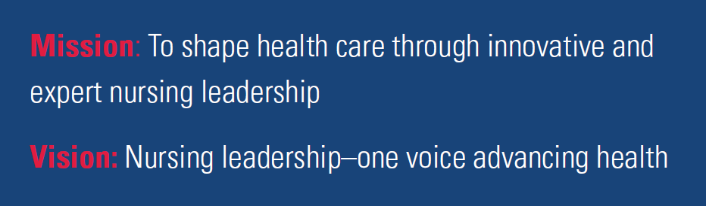
Slide Title Here
Bullet 1
Bullet 2
Bullet 3

Slide 5
Who is a nurse leader?
A. ICU Manager who saved dozens of lives during the devastating California wildfires?
B. Community nurse leader who – frustrated by the many opioid related deaths she’d seen – now trains community leaders how to administer naloxone.
C. System nursing vice president who implemented a staffing optimization effort improving work-life balance and decreasing labor costs.
D. All of the above

Slide 6
Driving Force
AONL believes leadership is demonstrated through influence and impact across the nursing professional continuum. Every nurse is a leader. As an organization, our strategic priorities and core work aim to support all nurses in their leadership journey.

Slide 7
American Organization for Nursing Leadership
The research indicated a distinct need for a new name. | Why the American Organization for Nursing Leadership
The word “executive” is a significant barrier to engagement with the organization for those who do not have “executive” in their title. Substantial misperceptions among external audiences about who AONE serves. Less hierarchical structures and increased focus on leadership at all levels and across the care continuum in the rapidly changing health care environment. | “Leadership,” as opposed to “Leader” or “Executive,” demonstrates focus on serving the field, as opposed to individuals. The “for” encompasses the organization’s desire to serve and elevate the field, highlighting leadership as a specialty. Maintains a connection back to the AONE brand to maintain brand recognition instead of a fundamental shift.
Notes:
Alyse

Slide 8
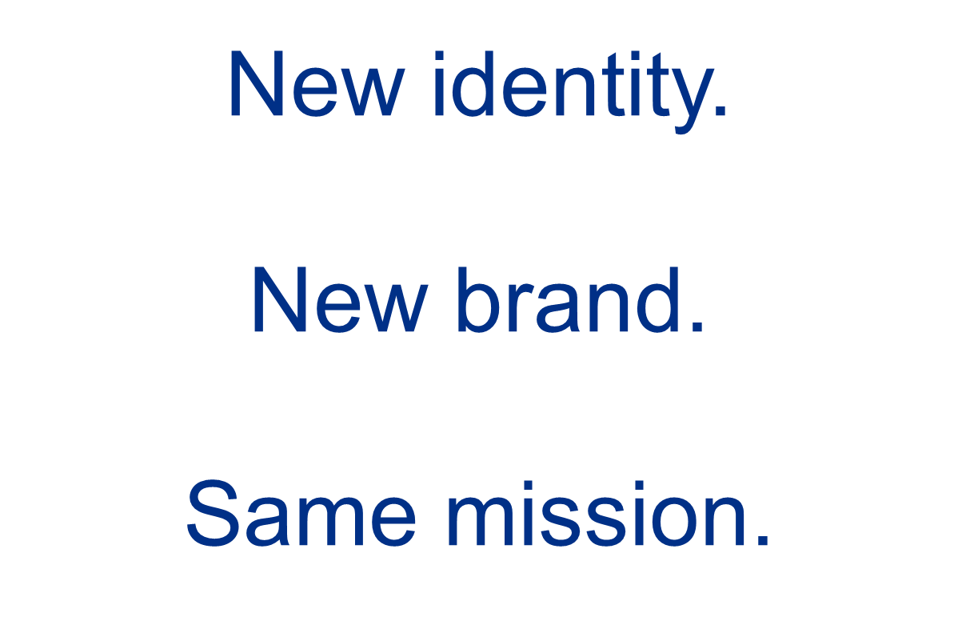
Notes:
The organization’s executive name continues is potentially limiting in terms of membership from non-executive level nurses.
The organization believes every nurse is a leader and is dedicated to inclusivity of all nurse leaders. Our strategic priorities and core work aim to support all nurses in their leadership journey.
Branding Work
We wanted to hear the field’s perception of AONL so we commissioned a study perceptions of the AONL brand among AONL members, former members and non-members. We listened. Learned. We are changing our name to the American Organization for Nursing Leadership.
We learned the name “American Organization of Nurse Executives” was a significant barrier to engagement, limiting the organization’s ability to focus on all nurse leaders, regardless of title or setting.

Slide 9

Changing a name and image is not easy

Slide 10

Formerly Known as Prince

Slide 11

Notes:
Video introducing new brand
https://youtu.be/lZQJQW-Zsgk

Slide 12





Slide Title Here
PRIORITY 1:
Advocate for nursing to shape the future of health care
PRIORITY 2:
Lead and influence the health care workforce
PRIORITY 3:
Advance and sustain evolving nursing leadership competencies
PRIORITY 4:
Advance and promote affordable, value-based health care
PRIORITY 5:
Strengthen AONL’s voice through a highly engaged, inclusive
and diverse membership
Bullet 1
Bullet 2
Bullet 3

Slide 13
Advocacy
Advance Agenda
Change Agent
Policy Solutions
Notes:
While AONL has always been active in advocacy, our 2018 member needs assessment indicated members ranked advocacy and the number one role they look to AONL to play.
As such, AONL is re-energizing our advocacy efforts in terms of how we advocate nationally at the organizational level but also how we engage our affiliates and grassroots members.
AONL’s advocacy agenda aligns with the AHA’s to
sustain gains in health coverage;
protect patient access to care;
advance health system transformation;
enhance quality and patient safety;
Promote regulatory relief
Strengthen the nursing workforce
We create agents of change through grassroots advocacy and influence. AONL Advocacy Day is our most visible representation of this. Join us May 15 in Washington DC.
We also engage our individual members to contact their legislators through action alerts. These messages notify advocates of key legislation pending and allow people to easily send a message to their legislators.
AONL works with coalition partners- like the nursing community- to advocate for legislative and regulatory solutions to workforce and finding issues using a unified voice.

Slide 14
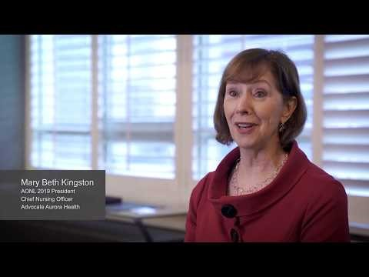
Advocacy
Notes:
https://youtu.be/8hgdnH2G74g

Slide 15

Notes:
AONL Advocacy Day is open to nurses at all levels of leadership: from bedside to executive, from academia to industry are invited as are non-nurses who support AONL’s agenda. Lobbyists and association leadership have also participated.
On May 15, representatives from 29 states advocated for Title VIII reauthorization, funding for nursing education and reducing barriers to care. Next year, we encourage you to come, bring your nurse managers, staff nurses. Past attendees noted the benefit of having groups made up of nurses at various leadership levels.
Some affiliates send a group every year and have gained new members from advocacy day. 1/3 of the participants are not current AONL members. Great member engagement and recruiting opportunity.
Registration includes admission to a welcome reception, hot breakfast, reception on the hill and multiple trainings.

Slide 16

Workforce Initiatives
Healthful work environment
Academic/practice partnerships
Career progression
Workforce: supply and
demand, staffing
Diversity and Inclusion
Notes:
AONE works to strengthen the nursing workforce through advocacy, resources, leadership development programs and partnerships.
A few years ago, AONE and the American Association of Colleges of Nursing created a joint committee to prepare nurses to practice in emerging models of interprofessional care.
Created leadership development programs to support nurses at every level along the career trajectory and care continuum.
AONE is committed to create a safe and healthy work environment. As part of the Tri-Council for Nursing, AONE supported the nursing civility proclamation. AONE led AHA’s efforts to mitigate workplace violence by working with the Emergency Nurses Association to develop guiding principles for nurse leaders to mitigate workplace violence.
I am the executive sponsor of the AHA’s Hospitals Against Violence Initiative’s workforce safety efforts.
As part of AONE’s advocacy agenda, we advocate for funding for nursing workforce development programs to bolster the nursing pipeline.

Slide 17
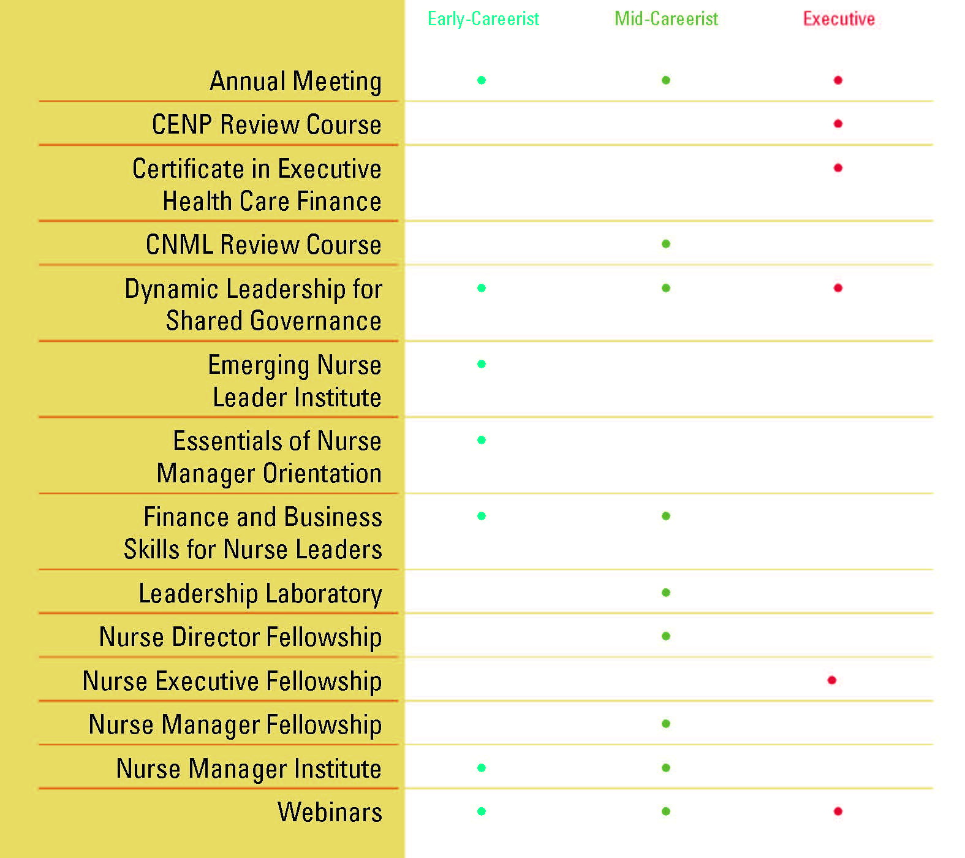
Education
Notes:
Educational programs cover all levels of leadership
Calendar of events can be found on AONL website
Organizations can bring most programs to their facility via a “hosted” model. This way the whole nursing leadership team can attend. Contact Beverly Hancock for additional information

Slide 18

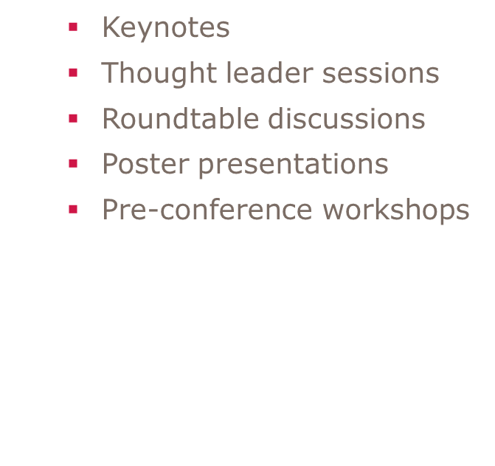
Education
Notes:
Largest education program of the year
More than 4,200 attendees
Lots of networking opportunities
Registration opens in November
Register as a non-member and receive 1 year of AONL membership

Slide 19

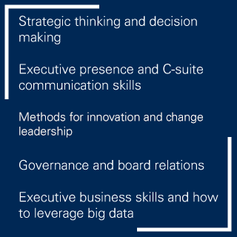
Education: New Program
Notes:
In January, AONL added an executive leader fellowship program for nurses who are novice CNOs, VPs and other C-suite positions. The program complements AONL’s existing nurse manager and nurse director fellowships.
The learning format combines in-person with virtual meetings, as well as webinars. The course focuses on strategic thinking and decision making; executive presence and communication; methods for innovation and change leadership; governance and board relations and executive business skills and leveraging big data. Participants will earn a Certificate in Executive Leadership as part of the program.

Slide 20
Affordable and Value-Based Care
Nursing Roles
Models of Care
Articulating and Demonstrating the Value of Nursing

Slide 21
Highly Engaged Diverse, Inclusive Membership
Diversity and Inclusion
Appointed Board Members
Committees and mentorship
Young Professional Voices
Notes:
Recognizing the importance of diversity and inclusion, AONL continues to find ways to include diverse perspectives.
AONL added the appointed board member positions in 2014 to increase the diversity of thought on the AONL board. WE are currently re-evaluating the process for selecting appointed board members and other strategies to improve and sustain diversity and inclusion in the organization
In addition to adding diversity to the AONL board, we tasked the AONL committees to include this in their work. The education committee creates leadership development programs for nurses along the career trajectory but also diversified how we offer our programs. From in-person sessions, to webinars to our new learning management system, we offer leadership development and content using a number of educational vehicles.
The continuum of care committee is tasked with developing initiatives to support the expanding role of nurse leaders across the continuum of care.
Membership committee was tasked with supporting and implementing membership recruitment and retention strategies to grow and strengthen the diversity of age, level of responsibility and organization setting of the AONL membership.
At the recommendation of the membership committee, AONL launched a Young Professional Voices recognition program to honor nurse leaders, at all levels, titles and organization settings, who exhibit significant potential as a health care leader and demonstrate exemplary leadership within their organization, community and the nursing profession.

Slide 22
Leadership Diversity in Nursing
Dearth of national statistics
Leadership roles do not reflect the diversity of clinical nurses
Higher turnover rate of nurses of color

Slide 23


Community: New recognition program
Notes:
AONL launched a fellow designation to recognize outstanding nurse leaders who made significant contributions to AONL and the specialty of nursing leadership. AONL will honoree the inaugural class of 18 nurse leaders at our Annual Meeting April 11 in San Diego.
The AONL fellow designation criteria includes AONL membership for seven years, and evidence of contributions to nursing leadership practice and AONL. A committee comprised of appointed volunteers reviewed the applications using pre-established, rigorous and defined standards. The AONL Board then approved the review committee’s selections. AONL will announce the fellow credential at its Annual Meeting in April.

Slide 24
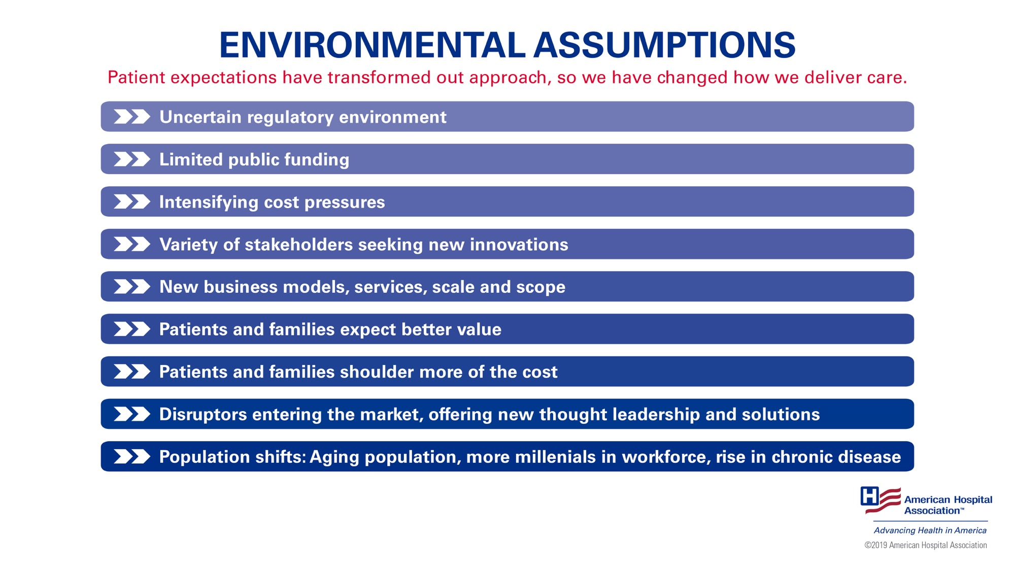
Environmental assumptions
Notes:
We’ve seen these forces at work here – in our hospital/health system.
Patient expectations have transformed our approach. At the same time, we have transformed what we can deliver.
Our regulatory environment is uncertain.
We have to become comfortable uncertainty and work together as a field to create our future desired state.
Public funding is limited.
Federal and state governments are troubled by rising per capita spending on health care and growing budget deficits, and must make tough choices as to which priorities to fund.
We are experiencing intensifying cost pressures.
An aging population, a rise in chronic disease and declining reimbursement all contribute to these pressures.
There are a variety of stakeholders seeking new innovations.
Individuals are increasingly viewing health care through a consumer lens and connecting in ways that make sense in today’s digital world. Providers are also looking for streamlined processes and technologies to provide seamless, coordinate care.
We are experiencing the development of new business models, services, scale and scope.
The move from volume to value-based health care has spurred different delivery models, such as accountable care organizations, patient-centered medical homes and bundled payments. To aid this movement, we have a renewed focus on population health management, new technologies and data analytics. Additionally, we have new models of interaction and data sources, including telehealth, wearables and mobile devices and apps.
Patients and families expect better value. And patients and families are shouldering more of the costs.
Affordability of health care is an urgent health care problem facing Americans. 92% of all Americans, regardless of political affiliation, think that all Americans should have the right to affordable health care. There is no simple way to address the myriad of societal, systemic, and operational factors that impact affordability. Moving the needle will require all health care participants – consumers, payers, hospitals, pharmaceutical companies, and community organizations – to innovate and adapt.
Disruptors are entering the market, and are offering new thought leadership and solutions.
Forces such as the rise of consumerism and the new digital economy are prompting changes in the way health care is delivered and how providers interact with patients. These massive transformations make the health care field ripe for disruptive innovations as entrants from inside and outside of health care look for new ways to deliver services … and new services to deliver.
We are experiencing shifts in the population, including an older population, more millennials in the workplace and a rise in chronic disease.
The U.S. population is aging. In 1970, 10% of adults were older than 65. In 2030, 20% of adults will be older than 65. These factors call for a differently designed age-friendly care delivery model that responds to older patients’ personal preferences, medical needs and values.
Millennials are the largest generation in the United States workforce, at 35%. This may change the way we work and communicate. Health care must address their concerns and develop their skills.
The number of Americans with multiple chronic conditions is rapidly on the rise—149 million today—and is expected to increase to 171 million by 2030. As we work to keep patients healthy this impacts the work we do both in and out of the hospital.

Slide 25
Implications for Nurse Leaders
Advocacy at the state and federal level
Partnerships
Workforce issues
Joy in work
Supply and Demand
Roles
Consumerism
Patient/Person and Family as Partner

Slide 26
Implications for Nurse Leaders cont’d
Social determinants of health
Care models
Focus on health and prevention
Chronic disease management
Innovation
Self-care and the role of technology
Nurses leading change in improving health and healthcare

Slide 27
Generative Leaders
Curious, never satisfied with status quo
Demonstrate resiliency
Anticipate and shape change
Seek out other experts and thought leaders
Influence others’ thinking
Reframe problems into possibilities
(Disch, 2009)

Slide 28

Importance of the Nursing Voice
Systems-oriented
Perceptive
Whole person-focused
Our work is human caring
Relationship-based
Astute problem-solvers
Practice based on evidence and expertise

Slide 29
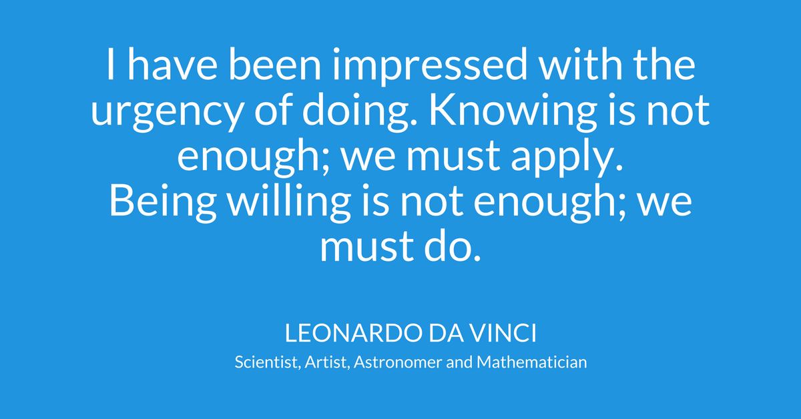

Slide 30

Questions

