Slide 1
Use of Aromatherapy to Reduce Symptom Burden in Patients Receiving Stem Cell Transplantation
Alexandra Thullen MSN, RN, AGCNS-BC, BMTCN
Monica Bates BSN, RN, OCN, BMTCN
Alyson Keen PhD, RN, ACNS-BC
Laura Basham MSN, RN, AGCNS-BC

Slide 2
Notes:
-The AHHC 750 beds, University 240 beds
-3E 28 beds- Hem/Onc BMT patients
-BMT Acuity adaptable 13 bed unit
-Autos/ Allos/ CAR-T Cell

Slide 3
Background
Symptom burden is a challenge for patients receiving chemotherapy.
Chemo-induced nausea, vomiting, & retching (CINVR)
Anxiety
Hematopoietic stem cell transplant (HSCT) patients may experience a higher symptom burden.
Greater than 90% are likely to experience emesis despite the use of anti-emetics (1).
Anxiety is a common symptom (2) due to prolonged hospitalization.
Inhaled aromatherapy with essential oils have been used to decrease nausea/vomiting and anxiety in the general oncology population (3,4).
Research is needed to understand the potential benefit of aromatherapy for patients receiving HSCT.
(1) Faiman, B. (2016). BMTCN certification review manual Pittsburgh, PA: Oncology Nursing Society.
(2) Seo, H. J., Baek, Y. G., Cho, B. S., Kim, T. S., Um, Y. H., & Chae, J. H. (2019). Anxiety and Depression of the Patients with Hematological Malignancies during Hospitalization for Hematopoietic Stem Cell Transplantation. Psychiatry Investig, 16(10), 751-758. doi:10.30773/pi.2019.07.12
(3) Farahani, M. A., Afsargharehbagh, R., Marandi, F., Moradi, M., Hashemi, S.-M., Moghadam, M. P., & Balouchi, A. (2019). Effect of aromatherapy on cancer complications: A systematic review. doi:10.1016/j.ctim.2019.08.003
(4) Keyhanmehr, A. S., Kolouri, S., Heydarirad, G., Mofid, B., & Mosavat, S. H. (2018). Aromatherapy for the management of cancer 2complications: A narrative review. Complementary Therapies in Clinical Practice. doi:10.1016/j.ctcp.2018.02.009
Notes:
Symptom burden is a challenge for patients receiving chemotherapy, with nausea/vomiting and anxiety being some of the most common symptoms causing distress. In particular, the burden experience by patients receiving hematopoietic stem cell transplant (HSCT) may far exceed symptom burden experienced by the general oncology population due to extremely high doses of chemotherapy. Hematopoietic stem cell transplant (HSCT), also call bone marrow transplant, is the process of infusing healthy stem cells into the human body to replace damaged cells caused by disease or cancer (“Stem Cell Transplantation”, n.d.). Prior to receiving a HSCT, patients must receive high doses of chemotherapy and/or radiation in order to help decrease the amount of damaged or cancerous cells in the body leaving room for the new cells to reach the bone marrow and grow into cancer free blood cells. Due to high doses of treatment patients receive prior to HSCT, greater than 90% are likely to experience emesis despite the use of anti-emetics (Faiman, 2016).
Systematic and narrative reviews found that use of inhaled aromatherapy with essential oils decreased nausea/vomiting (Farahani et al., 2019; Keyhanmehr et al., 2018; Toniolo et al., 2021) and anxiety (Boehm et al., 2012; Farahani et al., 2019; Kayhanmehr et al., 2018) in several studies in the general oncology population.
Additionally, randomized controlled trails have found statistically significant improvements in anxiety symptoms in participants that received inhaled essential oils compared to control (Blackburn et al., 2017; Ozkaraman et al., 2018).
Research is needed to expand translation of aromatherapy as an evidence-based practice to populations at high risk for treatment-related complications, such as HSCT. Findings from this study will enhance understanding of the efficacy of aromatherapy on symptom burden in the HSCT population.

Slide 4
Research Team
Bedside RN
Nurse manager/ director
CNS
Nurse Scientist
Complete Life
Idea generator
Connects RN with resources to pursue idea
Guides RN through process of nursing research
Physicians
Guides team through IRB, grant proposal, FDA approval, publication
Interdisciplinary group supporting alternative treatment options
Provide support and approval for project within patient population
Notes:
-Core Team
-Supporting Team

Slide 5
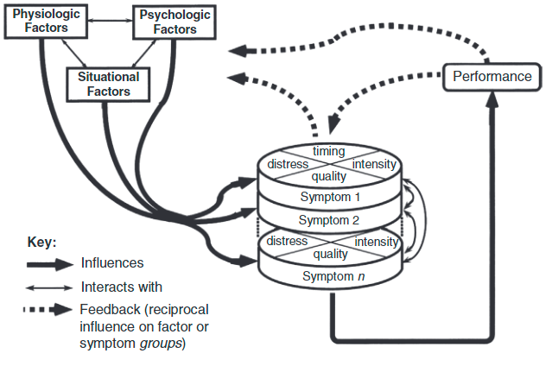
Theory of Unpleasant Symptoms
Lenz, E. R., & Pugh, L. C. (2014). The Theory of Unpleasant Symptoms In M. J. Smith & P. R. Liehr (Eds.), Middle Range Theory for Nursing: Third Edition (Vol. 3rd ed., pp. 165-195). New York: Springer Publishing Company.
Notes:
-This study is guided by the Theory of Unpleasant Symptoms, which is based on the belief that commonalities exist across symptoms that are experienced by diverse populations in a variety of situations (Lenz & Pugh, 2014). The theory focuses on three major concepts including symptoms, influencing factors (physiologic, situational, psychologic), and performance outcomes (Lenz & Pugh, 2014). The symptom itself and how the patient experiences it determines the performance of the patient cognitively, physically, and socially (Lenz & Pugh, 2014). The theory has been used most widely in oncology patient populations actively receiving treatment and for cancer survivors (Lenz & Pugh, 2014). Due to the high symptom burden in patients undergoing HSCT, the Theory of Unpleasant Symptoms will be relevant and support understanding of the effect of aromatherapy on perceived symptom experience.
-From this theory, we chose to focus on physiologic factors, situational factors, and symptom distress/quality/intensity/timing

Slide 6
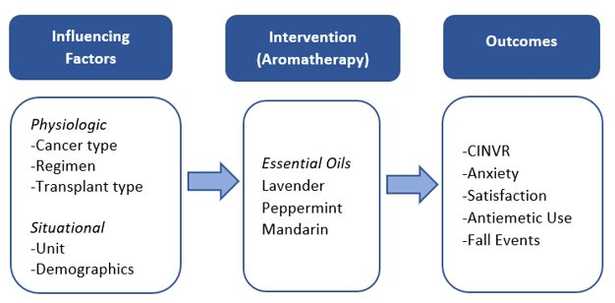
Conceptual Framework
Notes:
-Physiologic factors include type of cancer, treatment regimen, and transplant type the patient received. Situational factors include the unit the patient is hospitalized on and demographics (age, sex, race). The framework will be used to test the effect of aromatherapy essential oils (lavender, peppermint, or mandarin) on symptoms (CINVR and anxiety) and associated outcomes (intervention satisfaction, antiemetic administration, falls).

Slide 7
Purpose/Aims
Primary Aim
The purpose of this study is to evaluate the efficacy of aromatherapy on symptoms of chemotherapy-induced nausea, vomiting, and retching (CINVR) and anxiety for patients hospitalized for hematopoietic stem cell transplant. The primary aim will be to evaluate the effect of inhaled aromatherapy on CINVR and anxiety symptoms compared to control for 48 hours.
Secondary Aims
Evaluate patient satisfaction with aromatherapy at completion of study.
Evaluate the antiemetic administration between nausea/vomiting symptom intervention and control groups during the 48-hour intervention time span.
Evaluate the number and incidence of unit falls pre and post intervention.

Slide 8
Methods
Randomized controlled trial
Nausea/vomiting symptom group (25 intervention [peppermint or mandarin], 25 control)
Anxiety symptom group (25 intervention [lavender], 25 control)
Enrolled participants are on study for 48 hours
Aromatherapy patch changes Q8H
Symptom Diary: nausea/vomiting & anxiety assessed @ 0H, 24H, 48H
Aromatherapy satisfaction questionnaire completed @48H
Notes:
This was a randomized controlled trial that recruited inpatients receiving HSCT at a Midwest Comprehensive Cancer Center. Participants were randomized to intervention or control after self-selecting into the NV or A symptom group. Intervention participants received peppermint [or mandarin if peppermint intolerance] (NV) or lavender (A) patches and control participants received blank patches. Participants documented baseline, 24-, and 48-hour symptoms, patch changes, and aromatherapy satisfaction (48-hour only) in a symptom diary.
-Mixed model ANOVA was used to analyze symptoms between and within groups.
-T-test used to analyze the total number of antiemetic medications administered between nausea/vomiting group – control vs. intervention
-Descriptive statistics used to analyze frequencies and percentages of the patient satisfaction questionnaire responses, documented antiemetic administration, and number of unit falls.
-Adverse events were categorized in relation to the intervention and descriptive statistics were used to analyze aromatherapy satisfaction.

Slide 9
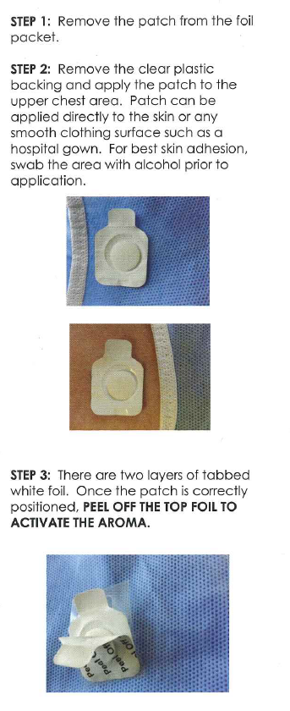
Intervention
Image from: What is Aromatherapy massage? - The benefits of aromatherapy (pereaclinic.com)
Notes:
-The hydrogel adhesive patches are infused with essential oil for inhaled aromatherapy treatment.
-The aromatherapy patches provide an occlusive barrier that is hypoallergenic, allowing essential oils to be inhaled without coming in direct contact with the skin.
-Additionally, patches are easy to apply and change for users and the product has been used in a randomized control trial in which participants completed patch changes and documented in a symptom journal (Lillehei et al., 2015), similar to our protocol procedures.

Slide 10
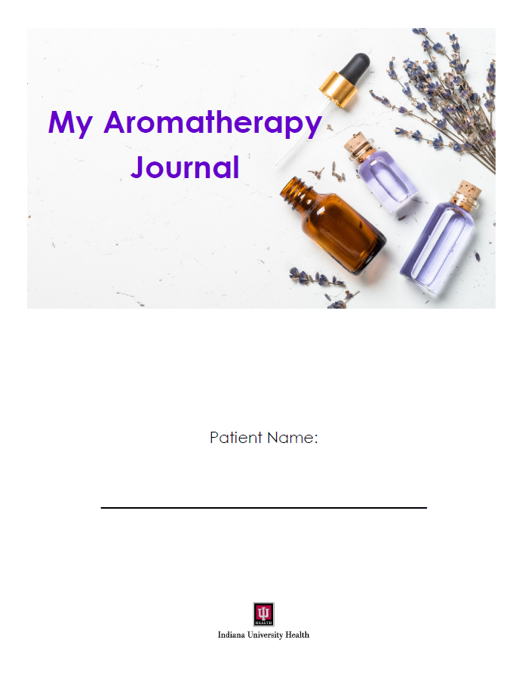
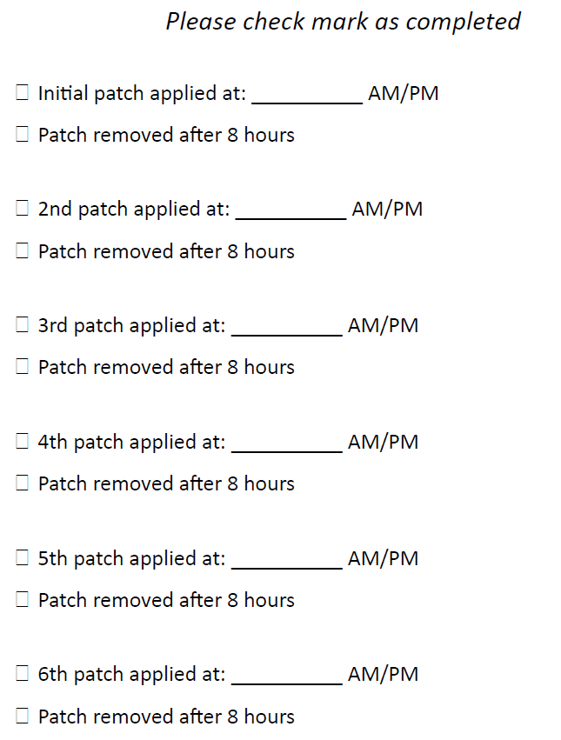
Journal
Notes:
After random assignment, participants were educated on how to use a symptom journal by a study team member and asked to complete the baseline symptom measures in the journal.
-Participants were instructed to repeat symptom measures at 24 & 48 hours
-Participants provided 6 patches (blank vs. Lavender/peppermint/mandarin) and instructed to change and document in the journal every 8 hours.

Slide 11
Rhodes Index of Nausea, Vomiting and Retching (INVR)
Used to measure CINVR
8 Likert-type items on 5-point scale
Evidence of Reliability & Validity
Participant self-assessment @ baseline, 24, & 48 hours in symptom journal
Rhodes, V. A., & McDaniel, R. W. (1999). The index of nausea, vomiting, and retching: a new format of the index of nausea and vomiting Oncology Nursing Forum, 26(5).
Notes:
A review of CINVR instruments identified the Rhodes Index of Nausea, Vomiting and Retching (INVR) was the only instrument that separately assesses all three symptoms (N/V/R). The INVR was used to measure CINVR and includes 8 Likert-type items on a 5-point scale, with evidence supporting reliability (Spearman correlation 0.87) and validity (Rhodes & McDaniel, 1999).

Slide 12
Spielberger's State Anxiety Inventory (SAI)
Shortened version used to measure state anxiety (1,2)
6 Likert-type items on 4-point scale
Evidence of Reliability & Validity
Participant self-assessment @ baseline, 24, & 48 hours in symptom journal
(1) Spielberger, C. D., Gorsuch, R. L., Lushene, R., Vagg, P. R., & Jacobs, G. A. (1983). Manual for the State-Trait Anxiety Inventory. Palo Alto, CA.
(2) Abed, M. A., Hall, L. A., & Moser, D. K. (2011). Spielberger's State Anxiety Inventory: Development of a Shortened Version for Critically Ill Patients. Issues in Mental Health Nursing, 32(4), 220-227. doi:10.3109/01612840.2010.546493

Slide 13
Aromatherapy Experience/Satisfaction
Tell me about your experience with aromatherapy in the hospital.
What was your satisfaction with aromatherapy on a scale of 1-10 (10 being extremely satisfied)?
How likely are you to use aromatherapy again in the hospital on a scale of 1-10 (10 being extremely likely)?
Notes:
@ 48 hours

Slide 14
Findings (n=92 participants)
Primary Aim
No statistically significant difference in symptoms between intervention and control in anxiety or nausea/vomiting group
Secondary Aims
No statistically significant differences in number of administered antiemetic medications comparing intervention to control in NV group
No difference in patient falls pre/post aromatherapy
68% (n=50) were highly satisfied and 72% (n=53) were likely to use aromatherapy again (ratings of >/=8, with 10 being extremely satisfied/likely)
No adverse events related to aromatherapy identified during study
Notes:
Mixed-model ANOVA with time (0H, 24H, 48H) repeated within subjects was used to compare symptom measures between intervention and control groups.
Chi square tests were used to compare the proportion of subjects taking each individual medication between the nausea intervention and control groups. In cases of small numbers in a cell, Fisher’s exact test was used.
The number of total antiemetic medications and the total dose of all antiemetic medications were compared between the nausea control and intervention groups using a t-test.
Descriptive statistics used to analyze frequencies and percentages of demographic information and satisfaction questionnaire

Slide 15
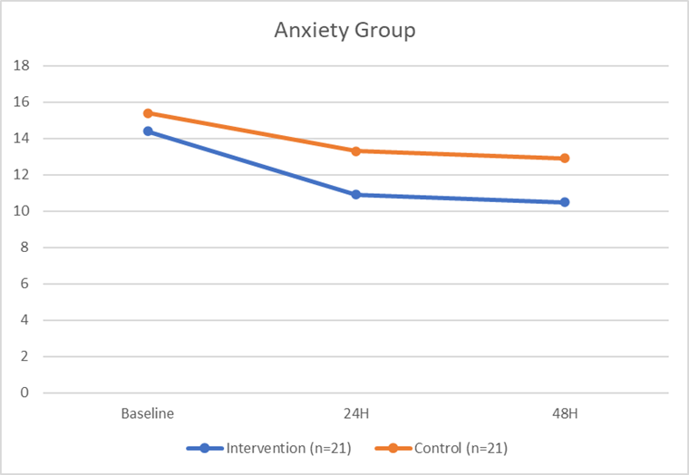
Anxiety Group: SAI Mean Scores

Slide 16
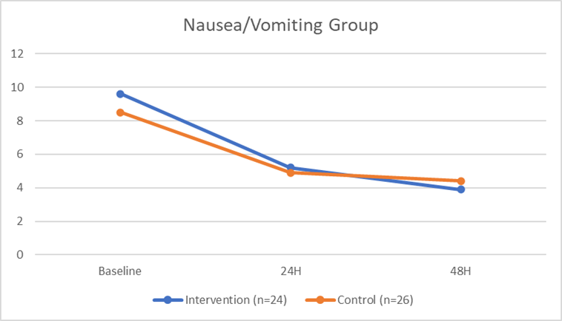
Nausea Vomiting Group: INVR Mean Scores

Slide 17
Magnet Document & Site Visit
Research Table
Magnet Story
Site Visit Presentation
Notes:
-First nurse-led RCT within organization
-Structural Empowerment (SE2EOa) - Patient experience "Did the staff do everything they could to help you with your discomfort" improved on 3East/BMT after aromatherapy implementation
-Clinical nurse able to share personal story and outcomes from the study with Magnet appraisers

Slide 18
Implications
Findings demonstrated safety and high satisfaction
Nonsignificant symptom differences between intervention and control
High acuity
Participant compliance with patch changes.
Findings support aromatherapy as a safe complimentary treatment for symptom management
Healthcare organizations should consider nurse-led complimentary therapies such as aromatherapy to improve the overall patient experience.
Team approach enabled clinical nurse to be a PI on RCT.
Notes:
Findings demonstrated safety and high satisfaction with aromatherapy.
Nonsignificant symptom differences between intervention and control
likely due to high acuity and challenges with participant compliance with patch changes.
Findings support aromatherapy as a safe complimentary treatment that can be combined with other supportive therapies such as massage, yoga, music, and art therapy for a holistic symptom management approach.
Healthcare organizations should consider nurse-led complimentary therapies such as aromatherapy to improve the overall patient experience.

Slide 19
Questions

